Slide 1
Volusia Sales Analysis ─ Recent Crimes ─
Diogo Nazario Cobos
CS540 Database & Data Retrieval Embry-Riddle Aeronautical University Spring 2021

Slide 2





FIRST STEPS
FIRST STEPS
Access Github reposi https://github.com/cobosd/diogo_volusia_sales_analysis
Access Github repository at: https://github.com/cobosd/diogo_volusia_sales_analysis
Download Zip file “ VolusiaProject.zip”
Extract files into a separate folder
Open folder for more information

Slide 3
DESCRIPTION
Inside the parent folder there are two distinct folders
“add_new_sales_analysis” is the main folder for this project. It will allow you to directly add a new “sales analysis – crime” table to your pgAdmin
“create_crime_table [optional]” contains extra steps and files to generate the original crime data table which was used to create the “sales analysis – crime” table
This presentation will focus on the main folder “add_new_sales_analysis”
If you would like to have your own crime table, please read the file “create_crime_table_steps” in the optional folder

Slide 4
ADD TABLE
Within “add_new_sales_analysis” folder there are two files
README file contain the only instruction to add the table to your pgAdmin and also some information about the attributes which were added
“crime_sales_analysis” is the .sql file which will be run. You can open it with Notepad if you would like to see line by line how the table is created
Open your Command Prompt
Go to the directory where the file “crime_sales_analysis.sql” was saved
Run the following (make sure the path to psql.exe is correct): "c:\Program Files\PostgreSQL\13\bin\psql.exe" -U postgres -d spatial -f crime_sales_analysis.sql

Slide 5
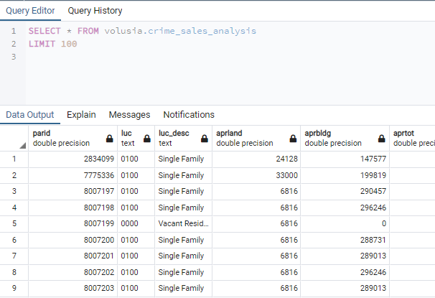
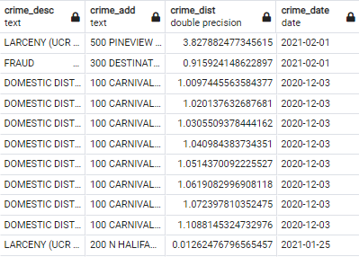
PGADMIN
Open and connect to your Postgres database through pgAdmin
The new table “crime_sales_analysis” should be found under the Volusia schema

